Slide 1


Alperovich Alexander
3/3/2007

Slide 2
Motivation
Find a maximal flow over a directed graph
Source and sink vertices are given
3/3/2007

Slide 3
Some definitions (just a reminder)
A flow network ➔ G = (V,E) a directed graph
Two vertices {s, t} the source and the sink
Each edge (u,v) ∈E has some positive capacity c(u,v), if (u,v) ∉E c(u,v) =0.
The flow function f maps a value for each edge where:
  f(u,v) ≤ c(u,v)
  f(v,u) = - f(u,v) ( skew symmetry )
Saturated edge (u,v) ⬄ c(u,v) = f(u,v)
3/3/2007

Slide 4
Some definitions, contd.
r(u, v) = c(u,v) – f(u,v)
Residual graph R(V, E`) where E` is all the edges (u,v) where r(u,v) ≥0
Augmenting path p is a path from to the source to the sink over the residual graph
f is a maxflow ⬄ there is no augmenting path
3/3/2007

Slide 5
Just as Dinic but…
We use the residual network
We don’t look for augmenting paths
Instead we saturate all outgoing edges of the source and strive to make this “preflow” reach the sink
Otherwise we’ll have to flow it back.
3/3/2007

Slide 6
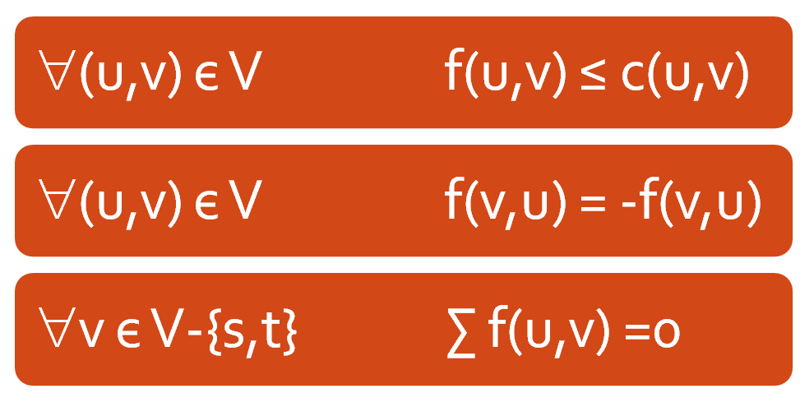
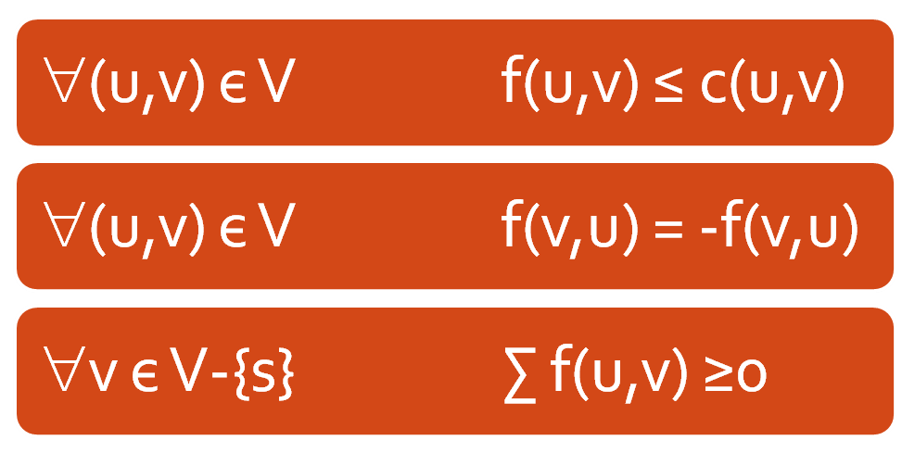
Preflow
Flow constrains:
Every vertex v may keep some “excess” flow e(v) inside the vertex
3/3/2007

Slide 7
Excess handeling
We strive to push this excess toward the sink
If the sink is not reachable on the residual network the algorithm pushes the excess toward the source
When no vertices with e(v) >0 are left the algorithm halts, and the resulting flow (!) is the max –flow
3/3/2007

Slide 8
Valid distance labeling
A mapping function d(v) → N + { ∞ }
d(s) = n, d(t) = 0
r(u,v) > 0 → d(u) ≤ d(v)+1
d(v) < n → d(v) is the lower bound on the distance from v to the sink (residual graph)
  Let p= v, v₁ ,v₂ , v_{3….} v_{k} ,t be the s.p v→t
  d(v) ≤ d(v₁) + 1 ≤ d(v₂) + 2 ..... ≤ d(t) + k = k
Same way d(v) ≥ n → d(v) -n is the lower bound on the distance from v to the source
3/3/2007

Slide 9
Active vertex
Active vertex:
  v є V-{s,t} is active if
    d(v) < ∞
    e(v) > 0
    Eventually, I’ll show that d(v) is always finite and therefore only the e(v) > 0 part is relevant
3/3/2007

Slide 10
Basic operations
Applied on active vertices only
Push (u,v)
  Requires: r(u,v) >0, d(u)=d(v)+1
  Action:
    δ = min( e(v) , r(u,v) )
    f(u,v) += δ, f(v,u) -= δ
    e(u) -= δ , e(v) += δ
3/3/2007

Slide 11
Basic operations , contd.
Relabel (u)
  Requires: ∀(u,v) є V r(u,v) >0 → d(u) ≤ d(v)
  Action:
    d(u) = min { d(v) +1 | r(u,v) >0 }
One of the basic operations is applicable on a active vertex:
  PUSH: Any residual edge (u,v) with d(u) = d(v) +1
  Otherwise: d(u) ≤ d(v) for all residual edges, allows relabel
3/3/2007

Slide 12
The algorithm
Initialize: d(s) = n, v є V-{s} d(v) =0
Saturate the outgoing edges of s
While there are active vertices apply one of the basic actions on the vertex
Simple, isn’t it?
Let’s see an example
3/3/2007

Slide 13
Example
- Saturate all source edges
4
4
0
2
2
2
S
0
T
2
2
4
1
0
0
3/3/2007

Slide 14
Example – contd.
4,4
4
2
2
2
S
2
T
2,2
4
1
0
0
4
0
2
2
2
6
0
0
2
4
1
0
0
Relabel

Slide 15
Example – contd.
4,4
4
2
2
2
S
2
T
2,2
4
1
0
0
4
0
2
2
2
6
1
0
2
4
1
0
0
Push

Slide 16
Example – contd.
4,4
6
2
2,2
2
S
0
T
2,2
4
1
0
0
Relabel
4
0
2
2
2
6
1
0
2
4
1
0
0

Slide 17
Example – contd.
4,4
6
2
2,2
2
S
0
T
2,2
4
1
0
0
Push (twice)
4
1
2
2
2
6
1
0
2
4
1
0
0

Slide 18
Example – contd.
4,4
2
2,2
2,2
2,2
S
0
T
2,2
4
1
0
2
4
1
2
2
2
6
1
0
2
4
1
0
Relabel
0

Slide 19
Example – contd.
4,4
2
2,2
2,2
2,2
S
0
T
2,2
4
1
0
2
Push
4
2
2
2
2
6
1
0
2
4
1
0
1

Slide 20
Example – contd.
4,4
0
2,2
0,2
2,2
S
2
T
2,2
4
1
0
2
4
2
2
2
2
6
1
0
2
4
1
0
1
Relabel, Push

Slide 21
Example – contd.
4,4
2
2,2
2,2
2,2
S
0
T
2,2
4
1
0
2
Relabel, Push
4
2
2
2
2
6
3
0
2
4
1
0
1

Slide 22
Example – contd.
4,4
0
2,2
0,2
2,2
S
2
T
2,2
4
1
0
2
4
4
2
2
2
6
3
0
2
4
1
0
1
Relabel, Push

Slide 23
Example – contd.
4,4
2
2,2
2,2
2,2
S
0
T
2,2
4
1
0
2
Relabel, Push
4
4
2
2
2
6
5
0
2
4
1
0
1

Slide 24
Example – contd.
4,4
0
2,2
0,2
2,2
S
2
T
2,2
4
1
0
2
4
6
2
2
2
6
5
0
2
4
1
0
1
Relabel, Push

Slide 25
Example – contd.
4,4
2
2,2
2,2
2,2
S
0
T
2,2
4
1
0
2
Relabel, Push
4
6
2
2
2
6
7
0
2
4
1
0
1

Slide 26
Example – contd.
2,4
0
2,2
2,2
2,2
S
0
T
2,2
4
1
0
2
2,2
7
2
2
2
6
7
0
2
4
1
Push
0
1

Slide 27
Example – contd.
2,4
0
2,2
2,2
2,2
S
0
T
2,2
2,4
1
2
0
2,2
7
2
2
2
6
7
0
2
2,2
1
0
Relabel
1

Slide 28
Example – contd.
2,4
0
2,2
2,2
2,2
S
0
T
2,2
2,4
1
2
0
2,2
7
2
2
2
6
7
0
2
2,2
1
1
Push
1

Slide 29
Example – contd.
2,4
0
2,2
2,2
2,2
S
0
T
2,2
2,4
1,1
1
0
2,2
7
2
2
2
6
7
0
2
2,2
1
1
Relabel, Push
1

Slide 30
Example – contd.
2,4
0
2,2
2,2
2,2
S
0
T
2,2
1,4
1,1
0
1
2,2
7
2
2
2
6
7
0
2
3,1
1
2
Relabel, Push
1

Slide 31
Example – contd.
2,4
0
2,2
2,2
2,2
S
0
T
2,2
2,4
1,1
1
0
2,2
7
2
2
2
6
7
0
2
2,2
1
2
Relabel, Push
3

Slide 32
Example – contd.
2,4
0
2,2
2,2
2,2
S
0
T
2,2
1,4
1,1
0
1
2,2
7
2
2
2
6
7
0
2
3,1
1
4
Relabel, Push
3

Slide 33
Example – contd.
2,4
0
2,2
2,2
2,2
S
0
T
2,2
2,4
1,1
1
0
2,2
7
2
2
2
6
7
0
2
2,2
1
4
Relabel, Push
5

Slide 34
Example – contd.
2,4
0
2,2
2,2
2,2
S
0
T
2,2
1,4
1,1
0
1
2,2
7
2
2
2
6
7
0
2
3,1
1
6
Relabel, Push
5

Slide 35
Example – contd.
2,4
0
2,2
2,2
2,2
S
0
T
2,2
2,4
1,1
1
0
2,2
7
2
2
2
6
7
0
2
2,2
1
6
Relabel, Push
7

Slide 36
Example – contd.
2,4
0
2,2
2,2
2,2
S
0
T
2,2
1,4
1,1
0
1
2,2
7
2
2
2
6
7
0
2
3,1
1
8
Relabel, Push
7

Slide 37
Example – contd.
2,4
1
2,2
2,2
1,2
S
0
T
2,2
1,4
1,1
0
0
Push
2,2
7
2
2
1,1
6
7
0
2
3,1
1
8
8

Slide 38
Example – contd.
1,4
0
2,2
2,2
1,2
S
0
T
2,2
1,4
1,1
0
0
3,1
7
2
2
1,1
6
7
0
2
3,1
1
8
8

Slide 39
Correctness
For an active vertex v, there must be a residual path v→…→s
  Otherwise, no flow enters v, and it is clearly not active
So, every active vertex v has an outgoing edge
  And this means, that if the distance labels are valid, v can be either relabled or pushed

Slide 40
Correctness of d(v)
r(u,v) > 0 → d(u) ≤ d(v)+1
By induction on the basic operations
We begin with a valid labeling
Relabel keeps the invariant
  By definition for the outgoing edges
  Only grows, so holds for all the incoming ones
Push
  Can only introduce (v,u) – back edge, but since d(u) = d(v)+1 the correctness is kept

Slide 41
Correctness of d(v) – contd.
For any active vertex v, d(v) < 2n
  Let p= v, v₁ ,v₂ , v_{3….} v_{k} ,s be a path v→s
  d(v) ≤ d(v₁) + 1 ≤ d(v₂) + 2 ..... ≤ d(s) + k = n+k
  The length of the path is ≤ n-1, so k ≤ n-1
  ➔ d(v) ≤ 2n-1
For a non active, it is kept when the vertex is active, or it is 0.
➔ d(v) is finite for any v during the run of the algorithm

Slide 42
Correctness contd.
At the end, for all the vertices besides {s,t} no excess is left in the vertices
  ➔ Our preflow is a flow
The sink is not reachable from the source on the augmenting graph
  Let p= s, v₁ ,v₂ , v_{3….} v_{k} ,t be a path s→t
  Notice k ≤ n-2
  n = d(s) ≤ d(v₁) + 1 ≤ d(v₂) + 2 ... ≤ d(t) + k+1 = k+1
  Implies that n ≤ k+1 in contradiction to above

Slide 43
Complexity analysis
d(v) ≤ 2n-1, and can only grow during the execution, and only by relabel operation
n-2 vertices are relabeled
  → At most (n-2)(2n-1) < 2n² = O(n²) relabels.
3/3/2007

Slide 44
Complexity analysis –
Saturating push
First saturating push 1 ≤ d(u) + d(v)
Last saturating push d(u) + d(v) ≤ 4n -3
Must grow by 2 between 2 adjutant pushes
→ 2n-1 saturating pushes on (u,v) [or (v,u)].
→m(2n-1) = O(nm) saturating pushes at all

Slide 45
Complexity analysis –
Non Saturating push
Φ = ∑d(v) | v is active
  Φ is 0 in the beginning and in the end
A saturating push increases Φ by ≤ 2n-1
  All saturating pushes worth O(mn²)
All relabelings increase Φ by ≤ (2n-1)(n-2)
Each non saturating push decreases Φ by at least 1
There are up to O(mn²) non saturating pushes

Slide 46
Complexity analysis
Any reasonable sequential implementation will provide us a polynomial algorithm
  How much a relabel operation cost?
  How much a push operation cost?
  How much cost to hold the active vertices?
How will we improve this?

Slide 47
Implementation
For an edge in {e = (u,v) | (u,v) єE or (v,u) єE } hold a struct of 3 values:
  c(u,v) & c(v,u)
  f(u,v)
For a vertex v єV we hold a list of all incident edges in some fixed order
  Each edge appears in two lists.
We also hold an “current edge” pointer for each vertex
3/3/2007

Slide 48
Implementation – contd.
Admissible arc in the residual graph
d(u) = d(v) + 1
u
Current edge
Push/relabel operation:
  If the current edge is admissible perform push on the current edge and return
  If the current edge is the last one, relabel the node and set the current edge to the first one in the list
  Otherwise, just advance the current edge to the next one in line
3/3/2007

Slide 49
Is this correct?
When we relabel a node we’ll have no admissible edges:
  Any of the other edges (u,v) wasn’t admissible before and d(v) can only grow
  If it had r(u,v) =0 before and now it is positive we had d(u) = d(v) + 1, and so d(v) < d(u)
Hold a list of all active nodes – O(1) extra cost per push/relabel operation
3/3/2007

Slide 50
And it costs
Number of relabelings – 2n-1 per vertex
Each relabeling causes a pass over all the edges of the vertex – m for all the vertices
Besides that we have o(1) per push performed (recall O(mn²) non saturating pushes).
Total – O(mn + mn²) = O(n²m)
3/3/2007

Slide 51
Use FIFO ordering
discharge(v) = perform push/relabel(v) until e(v) = 0 or the vertex is relabled
Hold two queues – one is the active, the other is for the next iteration
Iteration:
  While the active queue is not empty
    Discharge the vertex in the front
  Any vertex that becomes active is inserted to the other queue
3/3/2007

Slide 52
Use FIFO ordering - complexity
Φ = max d(v) | v is active
  Φ is 0 in the beginning and in the end
A relabel during an iteration can increase Φ by the delta of the relabel or keep Φ.
No relabel during an iteration will cause Φ to decrease by at least 1.
There are up to 2n² relabels during the run - 2n² iteration of the first kind.
3/3/2007

Slide 53
Use FIFO ordering - complexity
As each node can add up to 2n-1 to Φ, Φ grows by up to (2n-1)(n-2) during the entire run
O(2n²) iteration of the second kind as well
2n² + 2n² iterations → O(n²) iterations
Each iteration will have up to 1 non saturating push per vertex
O(n³) non saturating pushes at all
➔O(n³) total run time
3/3/2007

Slide 54
Dynamic tree operations
FindRoot(v)
FindSize(v)
FindValue(v)
FindMin(v)
ChangeValue(v, delta)
Link(v,w) – v becomes the child of w, must be a root before that.
Cut(v) – cuts the link between v and its’ parent
3/3/2007

Slide 55
The algorithm using dynamic trees
All that said before holds, but we also add dynamic trees
Initially every vertex is a one node dynamic tree.
The edges (u,v) that are eligible to be in the trees are those that hold
  d(u) = d(v)+1 (admissible)
  r(u,v) > 0
  (u,v) is the “current edge” of the vertex u
3/3/2007

Slide 56
The algorithm using dynamic trees
Yet, not all eligible edges are tree edges
If an edge (u,v) is in the tree v= p(u) and value(v) = r(u,v)
For the roots of the trees value(v) = ∞
3/3/2007

Slide 57
The Send operation
Requires: u is active
Action:
  while FindRoot(u) != u && e(u) > 0
    δ = min( e(u) , FindValue(FindMin(u)) )
    ChangeValue(u, -δ)
    while FindValue(FindMin(u)) == 0
      v = FindMin(u)
      Cut(v)
      ChangeValue(v, ∞)
Add the maximal
possible flow on
the path to the path
to the root
Remove all the
edges saturated
by the addition
3/3/2007

Slide 58
The Send operation – contd.
The send operation will either cause e(v) become 0, or it will make it the root
This implies v will not be active unless it is a root of a tree
3/3/2007

Slide 59
And the algorithm is…
As before – two queues etc.
Discharge the vertex in the front
  Use tree-Push/ Relabel instead of Push/ Relabel
We’ll set some constant – k – to be the upper limit of the size of a tree during the algorithm execution
3/3/2007

Slide 60
Tree-Push/Relabel operation
Applied on an active vertex u
If the current edge (u,v) is addmissible
  If (FindSize(u) + FindSize(v) ≤ k)
    Link (u,v), Send (u)
  Else
    Push (u,v), Send (v)
Else
  Advance the current edge
  If (u,v) was the last one cut all the children of u & Relabel(u)
3/3/2007

Slide 61
Tree-Push/Relabel operation – contd.
The operation insures that all vertices with positive excess are the roots of some tree
u
v
3/3/2007

Slide 62
Why is this correct?
Since inside the tree the d values strictly growing no linking inside the tree can occur
A vertex v will not have positive excess unless it is a root of a tree
  Link operation is valid if required
The rest is just as before
3/3/2007

Slide 63
Complexity Tree-Push/Relabel
Each dynamic tree operation is O(log(k))
Each Tree-Push/Relabel operation takes
  O(1) opearions
  O(1) tree opearions
  Relabeling time
  O(1) tree operations per cut performed
3/3/2007

Slide 64
Complexity – contd.
The total relabeling time is O(mn)
Total number of cut operations O(mn):
  Due to relabeling – O(mn)
  Due to saturating push – O(mn)
Total number of link operations < Number of cut operations + n → O(mn)
So we reach O(mn) tree operations + O(1) tree operations per vertex entering Q.
3/3/2007

Slide 65
How many times will a vertex become active?
Due to increase of d(v) – O(n²)
Due to Send operation, e(v) grows from 0
  Any cut performed – total (mn)
  One more per send operation
    Link case – O(mn)
    Push case - Need to split to saturating and not
    There can be up to O(mn) such saturating pushes
3/3/2007

Slide 66
Non saturating push analysis
For a non saturating push (u,v) either Tu or Tv must be large - contain more than k/2 vertices
For a single iteration, only 1 such push is possible per vertex
Charge it to the link or cut creating the large tree if it did not exist at the beginning of the phase – O(mn)
Otherwise charge it to the tree itself
3/3/2007

Slide 67
Non saturating push analysis – contd.
  There are up to 2n/k large trees at the beginning of the iteration
Total of O(n³/k) for all O(n²) iterations
➔ A vertex enters the Queue O(mn + n³/k) times due to a non saturating push
3/3/2007

Slide 68
Total complexity
Total of O(mn + n³/k) tree operations with tree size of k.
We reach total of O(log(k) (mn + n³/k)) runtime complexity
Choose k = n²/m
We reach O(log(n²/m) (mn)) runtime complexity
3/3/2007

Slide 69
Conclusion
We’ve seen an algorithm that finds a max flow over a network with O(log(n²/m) (mn)) runtime complexity
The algorithm uses a different approach – a preflow instead of flow
While providing same asymptotical result as Dinic, has better coefficients and therefore often used in time demanding applications
3/3/2007

Slide 70
Questions?
Thank you for listening
3/3/2007

